Slide 1
NAME: CHANGALA SIDDAIAH VARA PRASAD
REGISTER NO.: au211521243034
COLLEGE: Panimalar Institute of Technology
Email: c.s.varaprasad143@gmail.com
Final Project
3/21/2024 Annual Review
1

Slide 2
Generating Synthetic Handwritten Digits with GANs
Generative Adversarial Networks (GANs) represent a revolutionary advancement in artificial intelligence, particularly in the domain of computer vision. In the pursuit of creating synthetic data that closely resembles real-world examples, GANs have emerged as a powerful tool. One captivating application of GANs is in the generation of synthetic handwritten digits.
Traditionally, handwritten digit datasets like MNIST have served as benchmarks for evaluating machine learning algorithms. However, with the advent of GANs, we can now generate synthetic handwritten digits with remarkable realism. This capability opens up a plethora of possibilities across various domains.
In this presentation, we'll delve into the fascinating realm of generating synthetic handwritten digits using GANs. We'll explore the training process, the challenges involved, and the potential applications of this technology.
3/21/2024 Annual Review
2

Slide 3

AGENDA
Goal: In this presentation, we'll delve into the fascinating realm of generating synthetic handwritten digits using GANs. We'll explore the training process, the challenges involved, and the potential applications of this technology.
Introduction to GANs: Understanding the basics of Generative Adversarial Networks (GANs) and their role in generating synthetic data.
Project Objective: Exploring the objective of the project: to create synthetic handwritten digits using GANs, and its significance in various applications.
Dataset Overview: Introduction to the MNIST dataset, a widely-used dataset for handwritten digit recognition, and its importance in training and evaluation.
Training Process: Delving into the training process of GANs, including the adversarial learning mechanism between the generator and discriminator.
3/21/2024 Annual Review
3

Slide 4

PROBLEM
STATEMENT
The task is to develop a Generative Adversarial Network (GAN) model capable of generating synthetic handwritten digits resembling those from the MNIST dataset. The primary goal is to train the GAN model to produce realistic digit images that closely resemble real handwritten digits. This involves training a generator network to generate synthetic digit images and a discriminator network to distinguish between real and synthetic images.
The synthesized digits should exhibit diverse styles and variations while maintaining high fidelity to the characteristics of handwritten digits. The generated digit images can be further utilized for various downstream tasks, including digit recognition, data augmentation, and enhancing the robustness of machine learning models trained on digit datasets.
3/21/2024 Annual Review
4

Slide 5

PROJECT
OVERVIEW
Data Preparation:
Utilize the MNIST dataset, comprising 28x28 grayscale images of handwritten digits (0-9), for training the GAN model.
Normalize pixel values between 0 and 1 to prepare the dataset for training.
Model Architecture:
Design a GAN model consisting of a generator network and a discriminator network.
Generator network generates synthetic digit images from random noise, while discriminator network evaluates the authenticity of both real and synthetic images.
Training Process:
Train the GAN model iteratively in an adversarial manner.
Generator aims to produce increasingly realistic digit images to deceive the discriminator, while the discriminator learns to distinguish between real and synthetic images.
4. Visualization and Analysis:
1. Employ various visualization techniques to gain insights into the generated data.
3/21/2024 Annual Review
5

Slide 6

WHO
ARE
THE
END
USERS?
Researchers in Computer Vision:
Utilize synthetic handwritten digits for benchmarking and testing new algorithms and models in computer vision research.
Machine Learning Practitioners:
Employ synthetic dataset for training and validating digit recognition models, enhancing generalization and robustness.
Educators and Students:
Utilize synthetic dataset as educational material for learning about GANs, data generation techniques, and digit recognition algorithms.
Developers of Digit Recognition Systems:
Use synthetic dataset for testing and validating digit recognition systems, ensuring accurate performance in real-world scenarios.
Researchers in Generative Models:
Explore synthetic dataset as a benchmark for evaluating and improving generative models, fostering advancements in adversarial learning research.
3/21/2024 Annual Review
6

Slide 7

YOUR
SOLUTION
AND
ITS
VALUE
PROPOSITION
Solution: Leveraging GANs to generate synthetic handwritten digits enhances data diversity, improves model generalization, and fosters research advancements in digit recognition.
Enhanced Data Diversity: The synthetic dataset augments the existing MNIST dataset, providing a diverse range of digit images that can improve the performance and robustness of digit recognition models.
Cost and Resource Efficiency: Generating synthetic data using GANs eliminates the need for manual data collection and labeling, saving time, effort, and resources required for acquiring real-world data.
Improved Model Generalization: By training digit recognition models on a combination of real and synthetic data, the models are better equipped to handle variations and anomalies present in real-world scenarios, leading to improved generalization and performance.
3/21/2024 Annual Review
7

Slide 8

THE
WOW
IN
YOUR
SOLUTION
Harnessing the power of Generative Adversarial Networks (GANs) to seamlessly generate diverse and realistic handwritten digits not only revolutionizes data augmentation but also ignites innovation and fosters breakthroughs in digit recognition algorithms.
3/21/2024 Annual Review
By seamlessly producing diverse and lifelike handwritten digits, our utilization of Generative Adversarial Networks (GANs) not only redefines data augmentation but also sparks transformative advancements in digit recognition, captivating the realms of artificial intelligence and computer vision with unparalleled ingenuity.
8

Slide 9
MODELLING
Teams
cam add
wireframes
Architecture Design: Define the generator and discriminator networks' architecture, including the number of layers, activation functions, and architectural parameters, ensuring they are capable of generating realistic handwritten digits.
Data Preprocessing: Preprocess the MNIST dataset by normalizing pixel values and reshaping input data to match the model's input requirements, ensuring the data is properly formatted for training.
Model Compilation: Compile the generator and discriminator networks with appropriate loss functions, optimizers, and performance metrics, ensuring they are configured to effectively learn and differentiate between real and synthetic images.
Training Setup: Define training hyperparameters such as batch size, number of epochs, and learning rate, setting up callbacks for monitoring training progress and early stopping to prevent overfitting.
Training Process: Train the GAN model iteratively in an adversarial manner, feeding batches of real and synthetic data to the discriminator and generator networks, respectively, and updating network weights based on loss gradients to improve performance.
3/21/2024 Annual Review
9

Slide 10
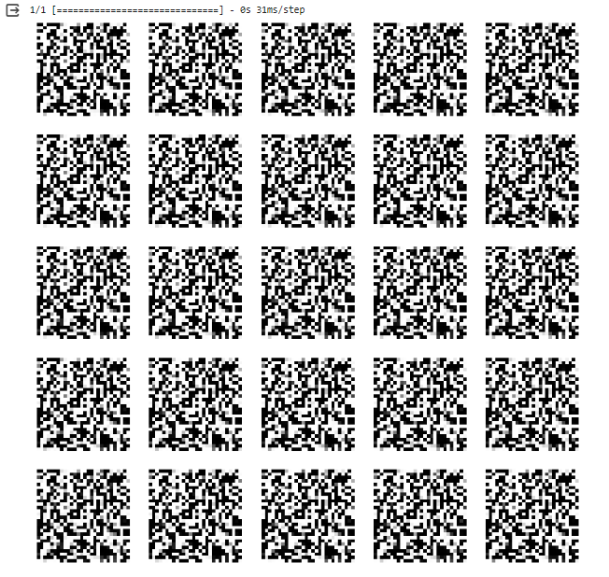
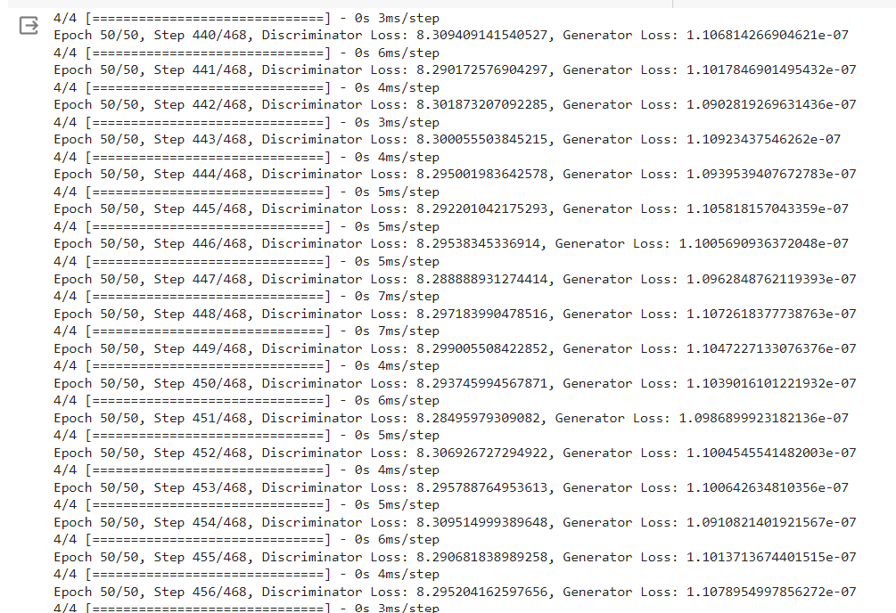
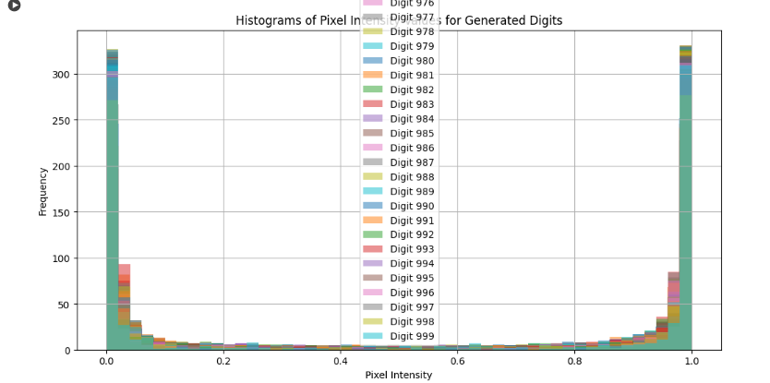
RESULTS
Github:https://github.com/varaprasad144/TNSDC-GENERATIVE-AI
3/21/2024 Annual Review
10

